Slide 1

Final Assessment excel -------------------------------------------------------------------------------------------------------------------------------------------------- NANDHA S P

Slide 2
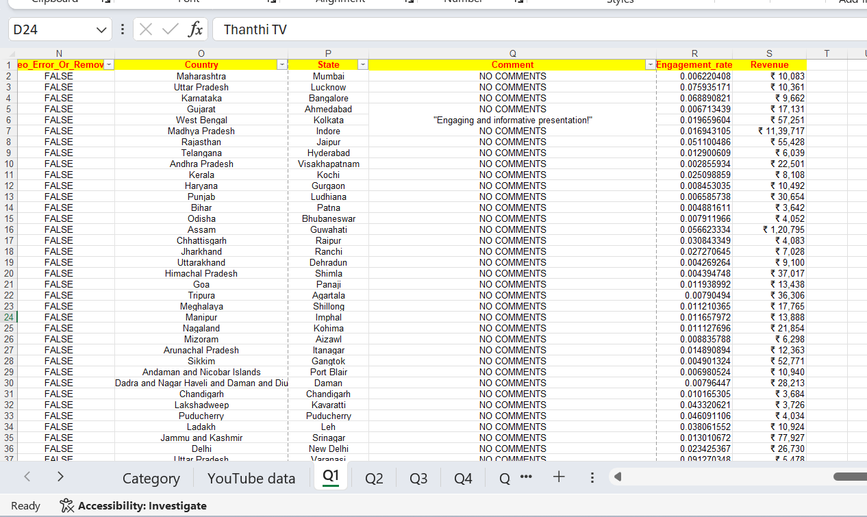
Q1
Insights – used remove duplicates,special selects and filled the empty comments with “no comments”

Slide 3
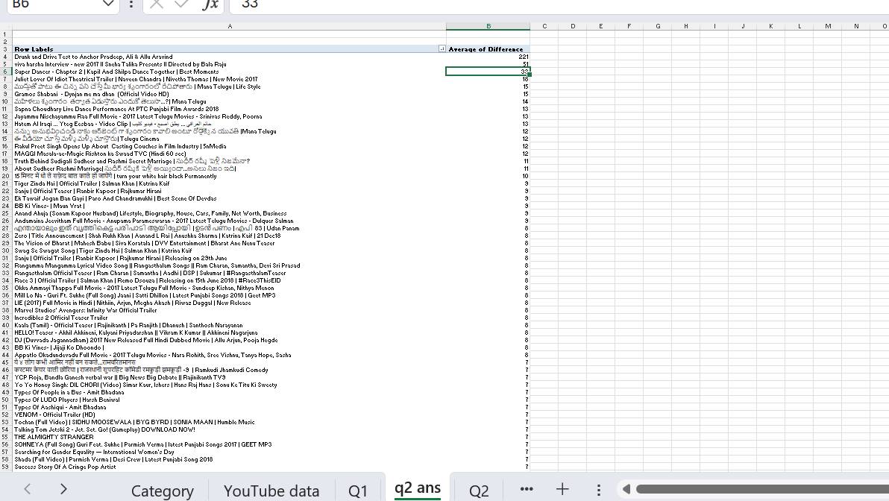
Q2
Insights- there are 136 videos which are trend in its published day

Slide 4
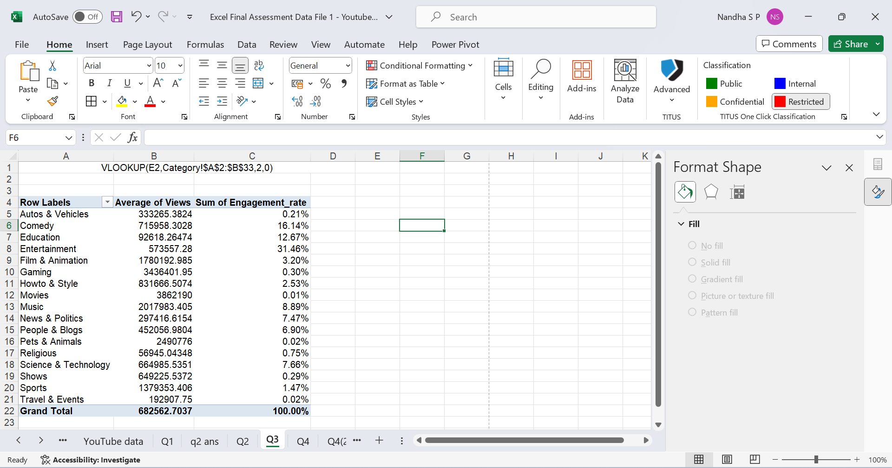
Q3
Insights- Entertainment has engaged more viewers

Slide 5
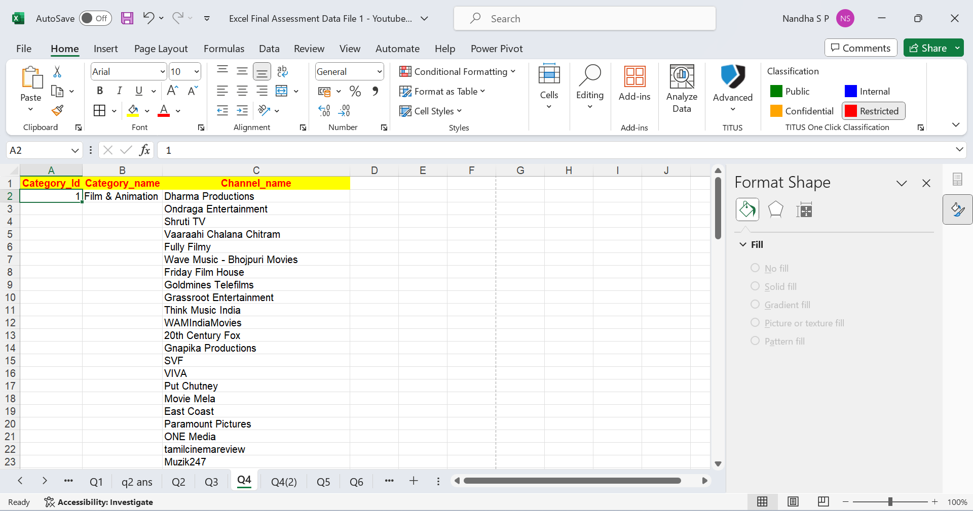
Q4
Insights - =UNIQUE(FILTER('Q1'!D2:D16247,'Q1'!E2:E16247='Q4'!A2,"No Data"))
=XLOOKUP(A2,Category!$A$2:$A$33,Category!$B$2:$B$33,"No Data")

Slide 6
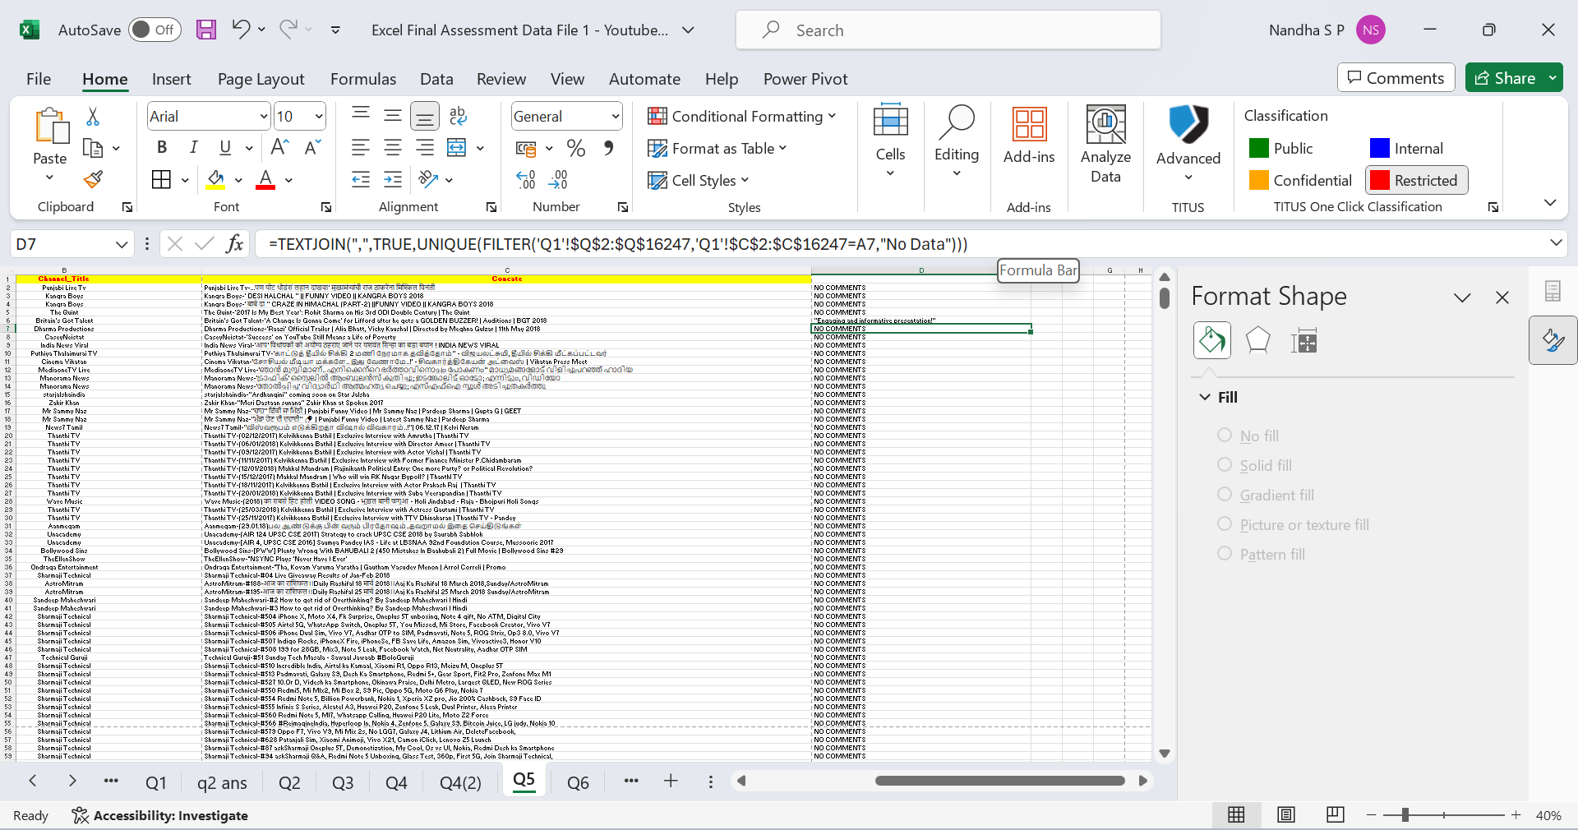
Q5
Insights- the comments were joined using textjoin

Slide 7
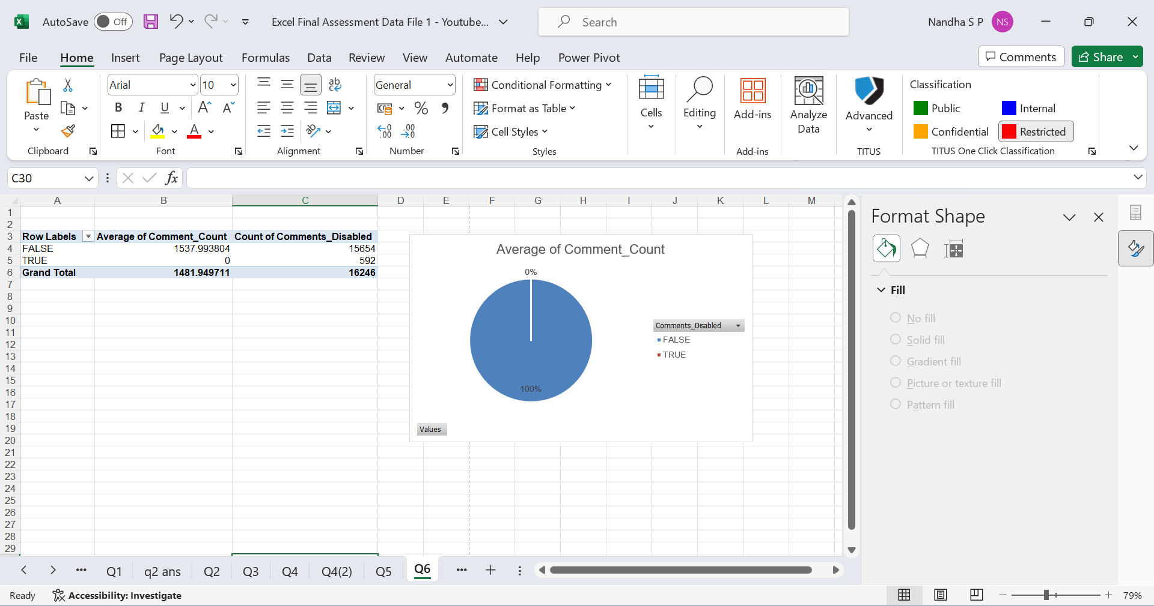
Q6
Insights

Slide 8
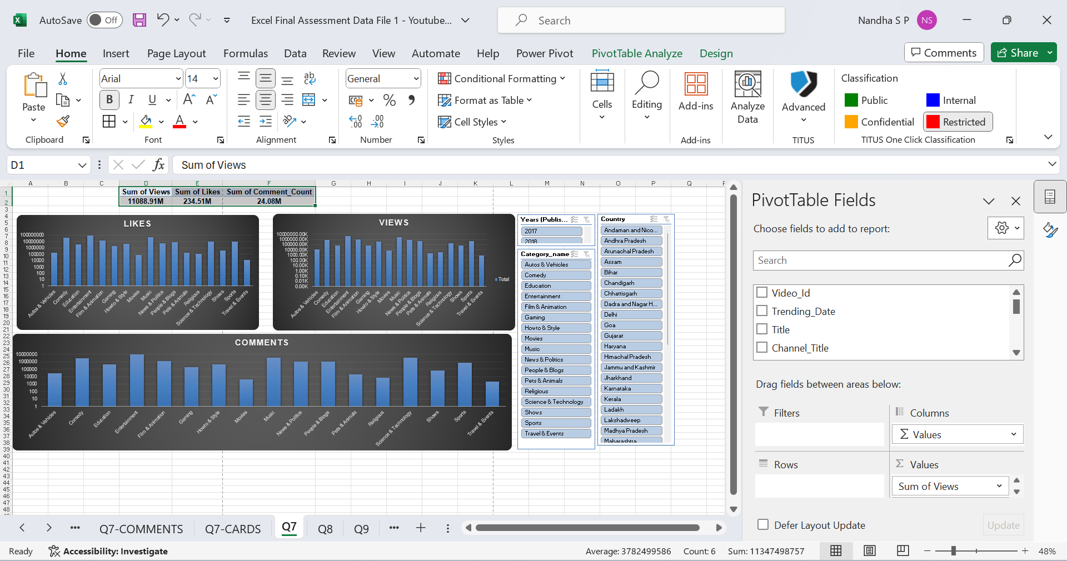
Q7
Insights

Slide 9
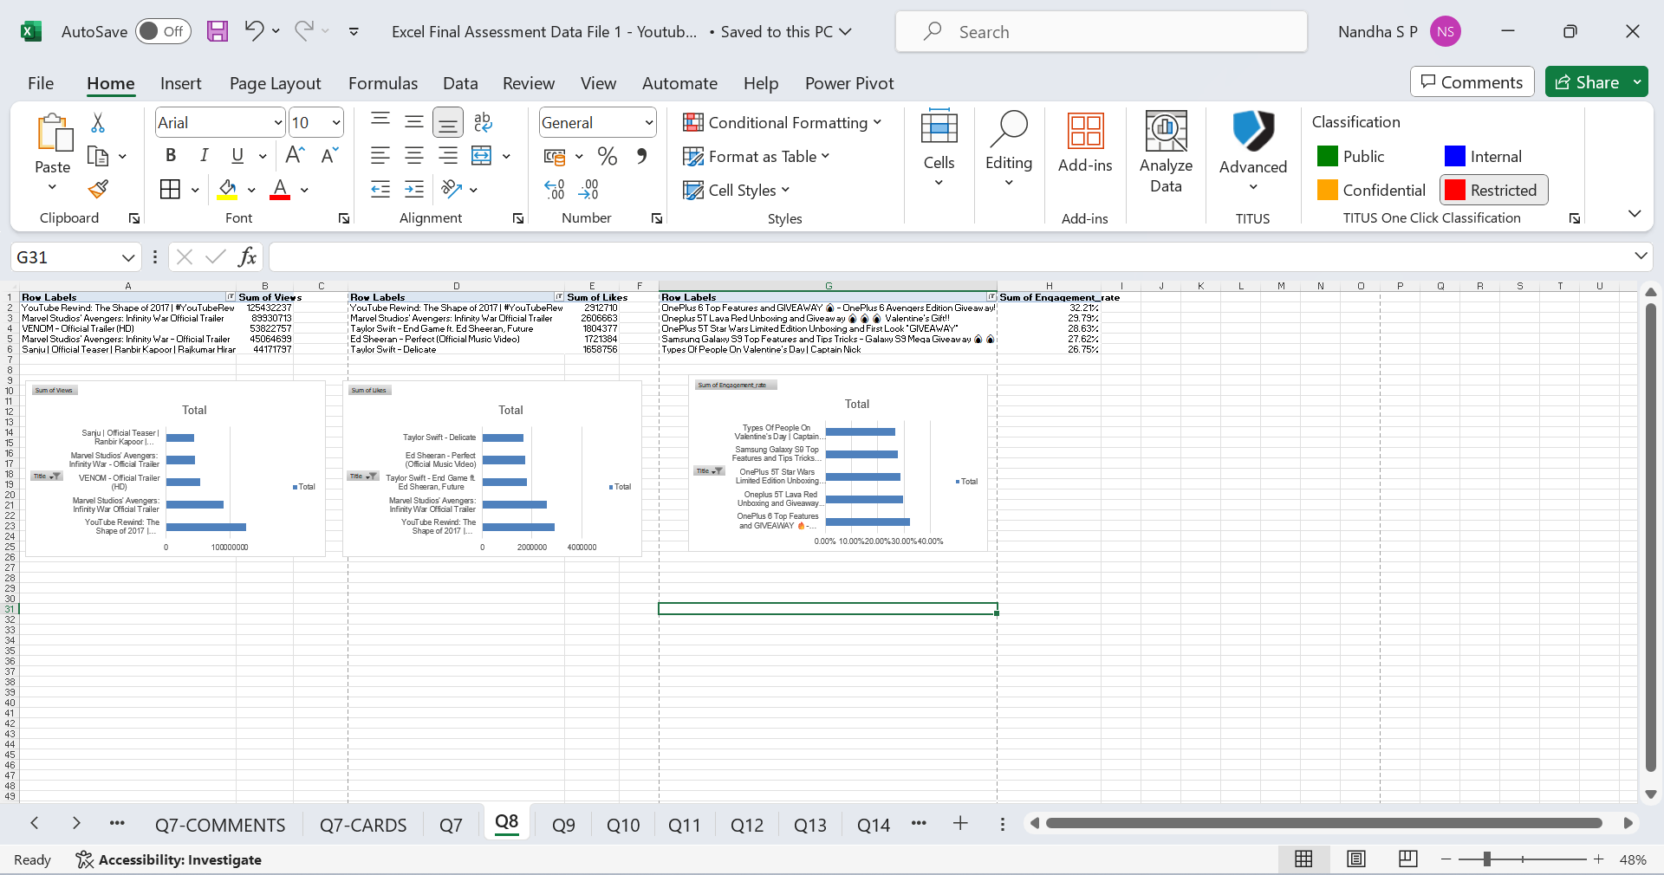
Q8
Insights

Slide 10
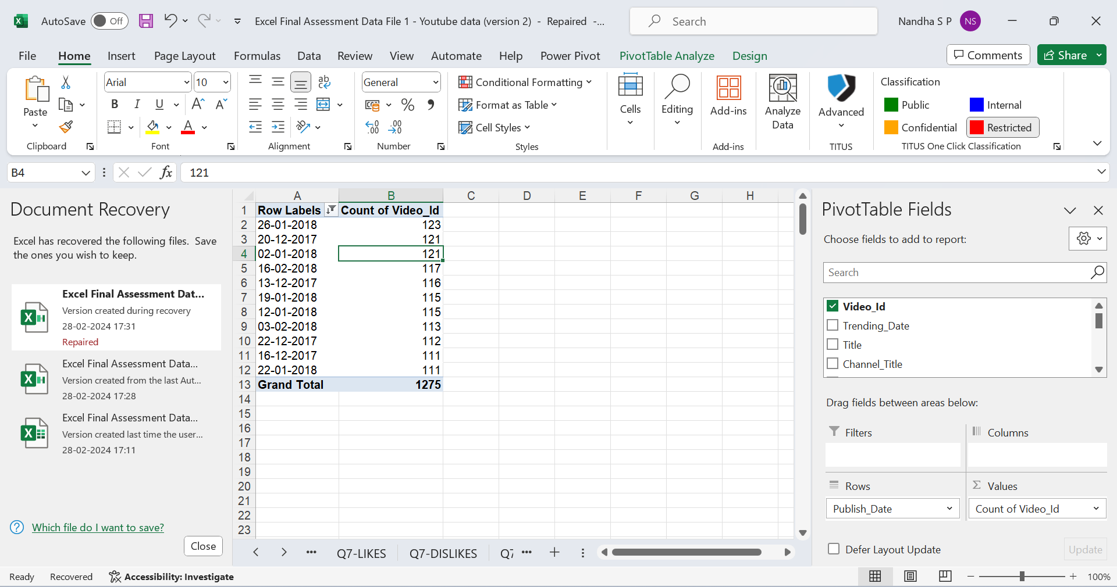
Q9
Insights- more no of videos were uploaded on 26-01-2018

Slide 11
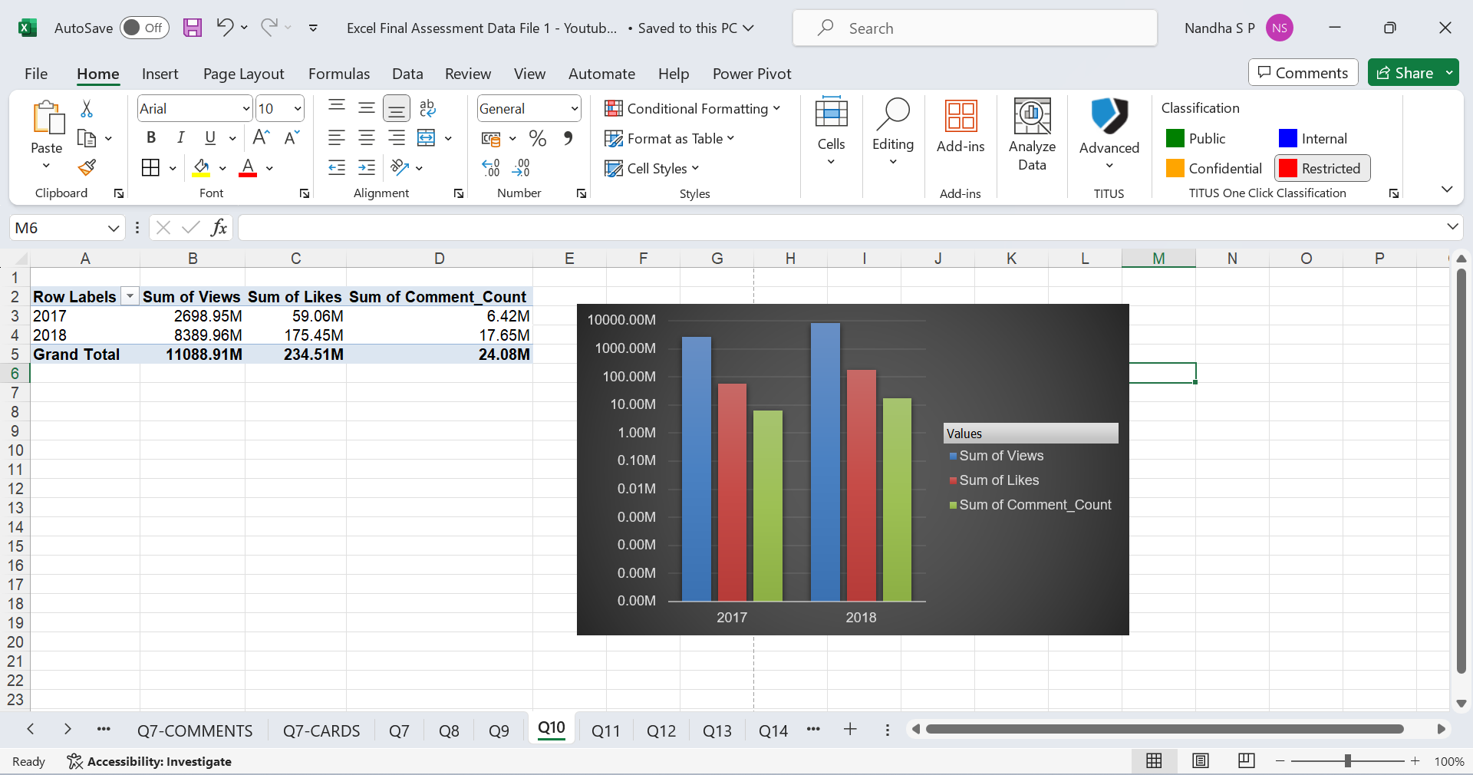
Q10
Insights

Slide 12
Q11
Insights

Slide 13
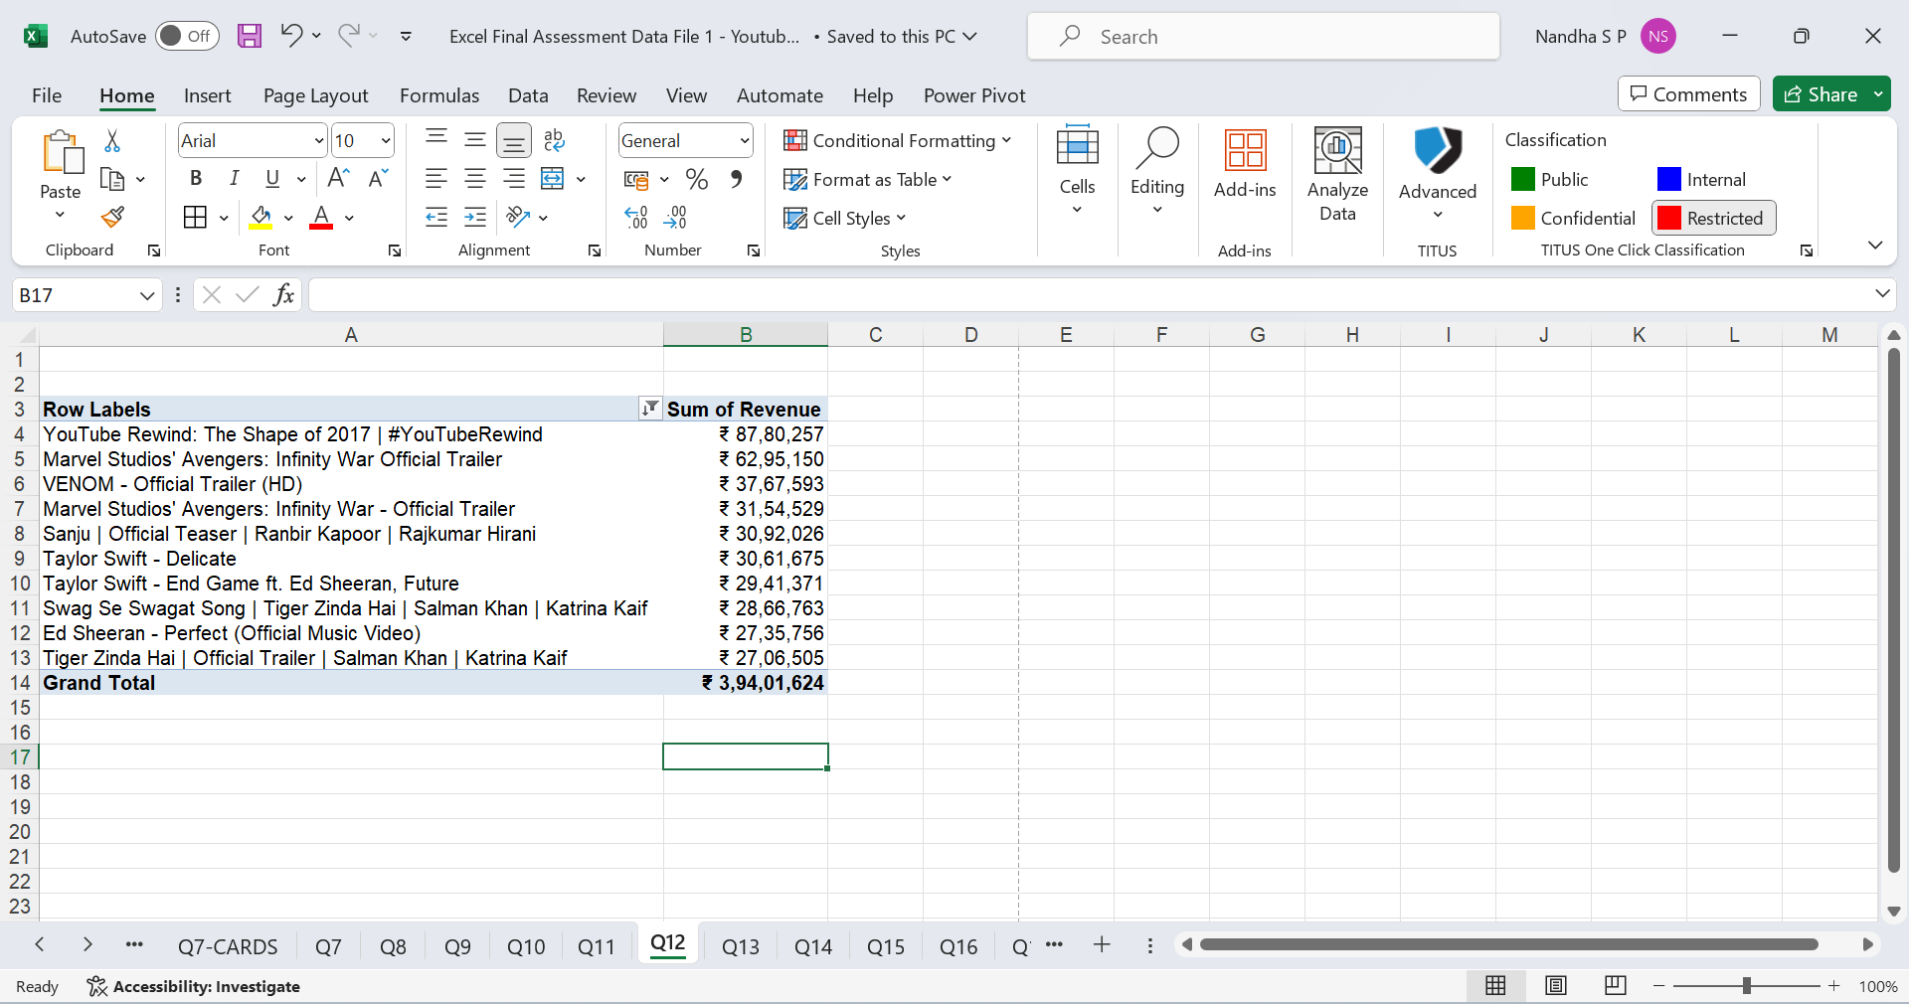
Q12
Insights

Slide 14
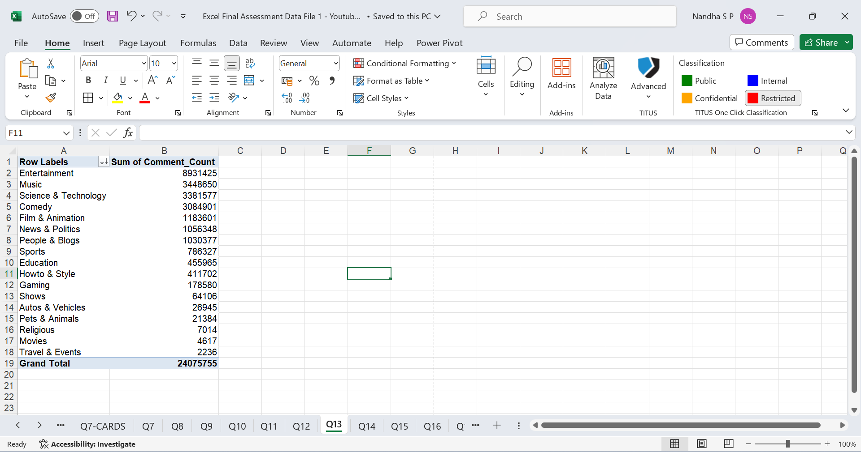
Q13
Insights – entertainment has more comments

Slide 15
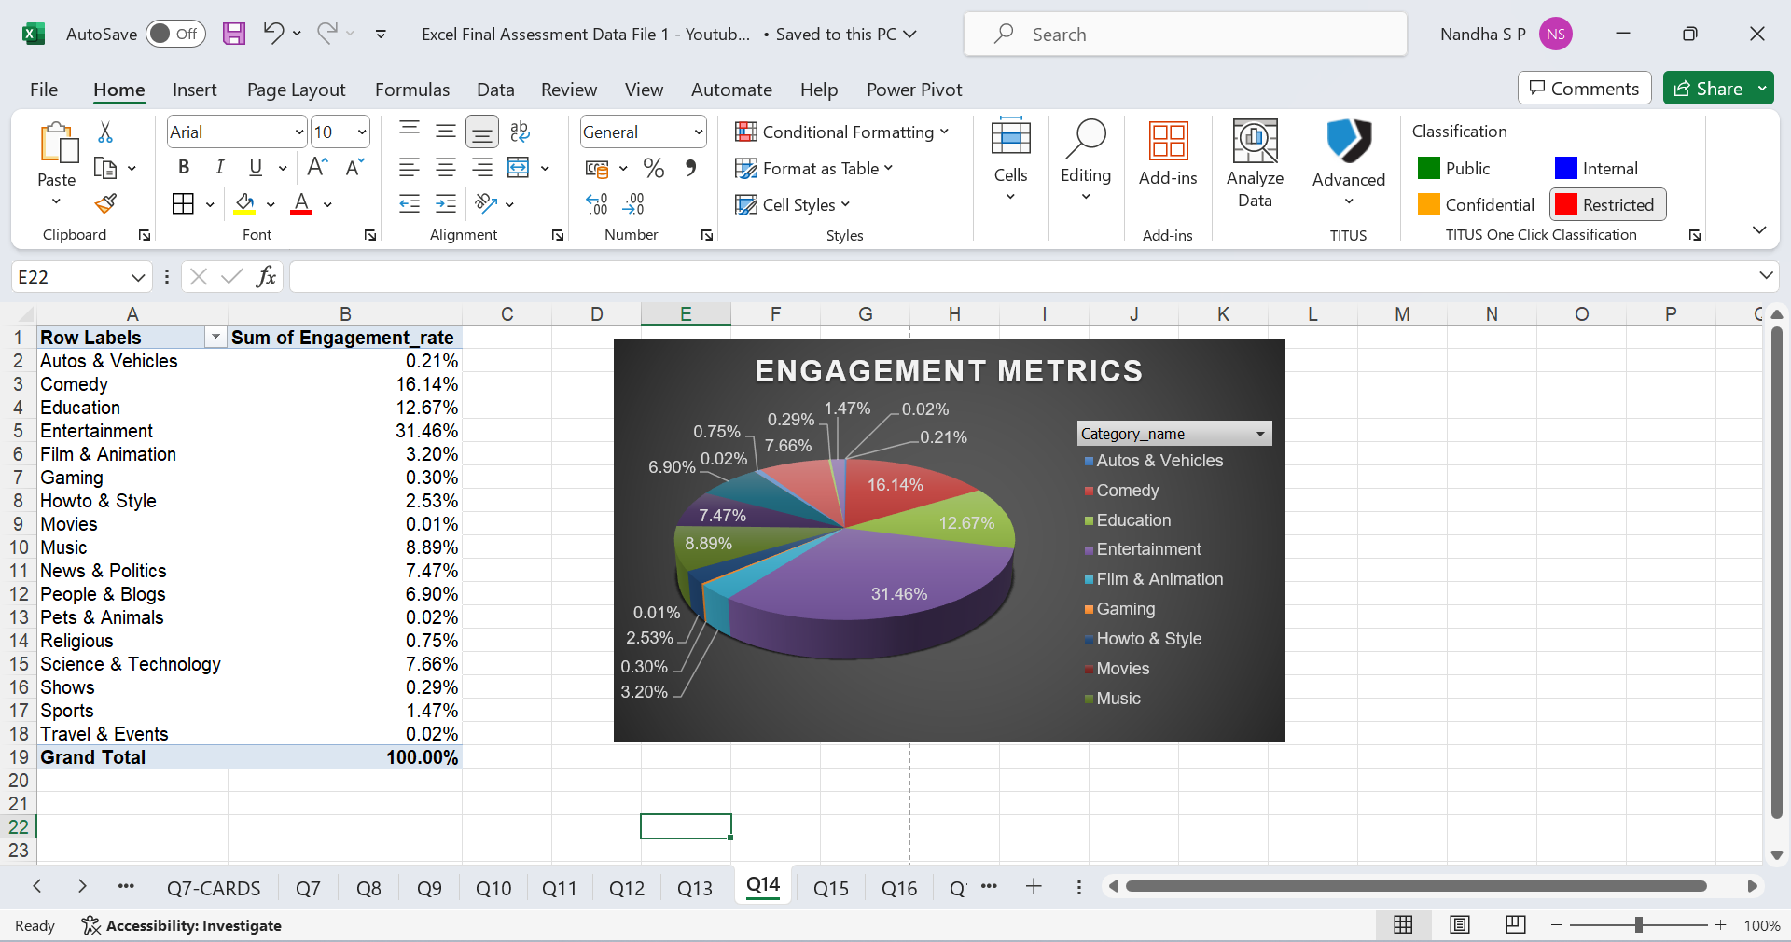
Q14
Insights- entertainment has more engagementmetrics

Slide 16
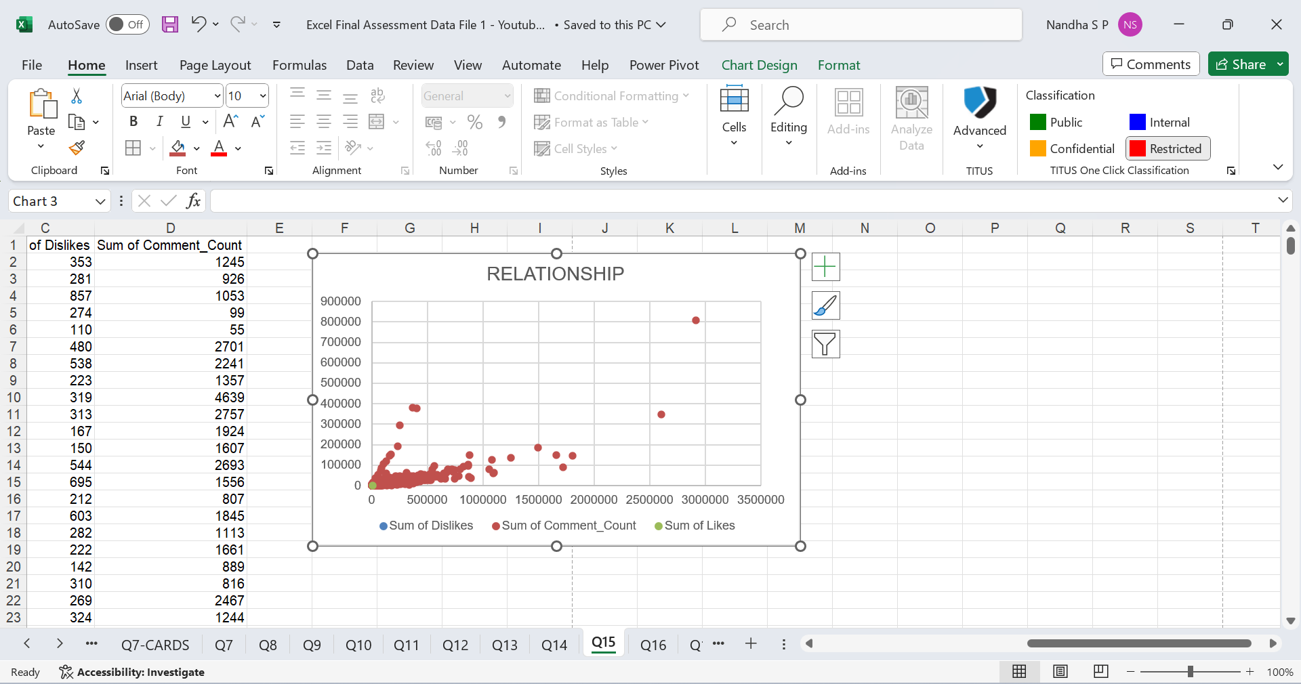
Q15
Insights – more views more comments and likes

Slide 17
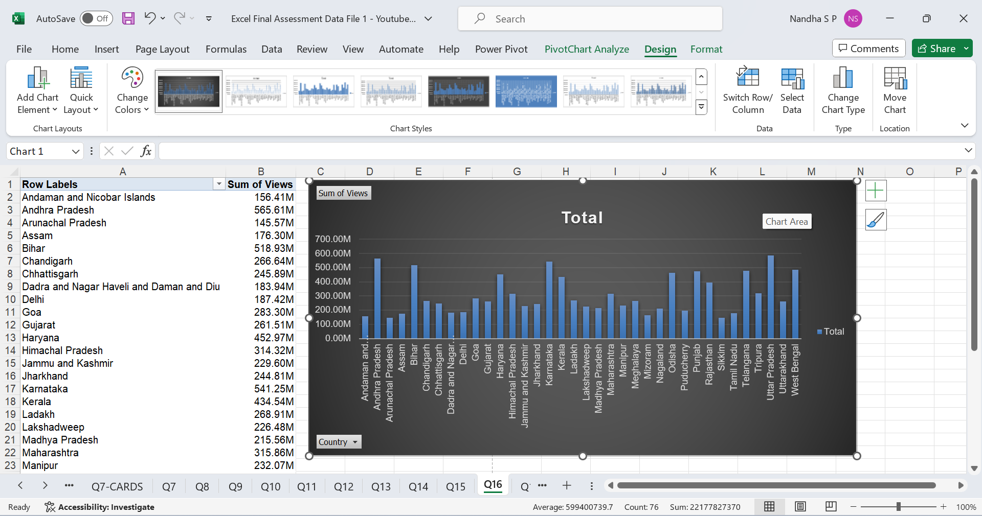
Q16
Insights

Slide 18
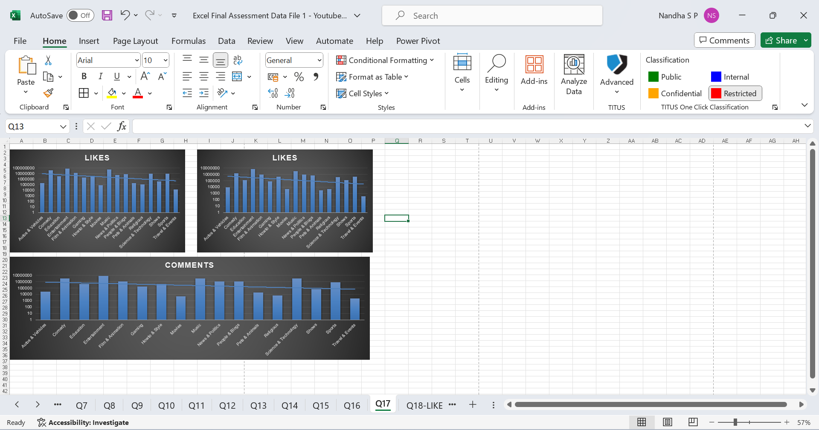
Q17
Insights

Slide 19
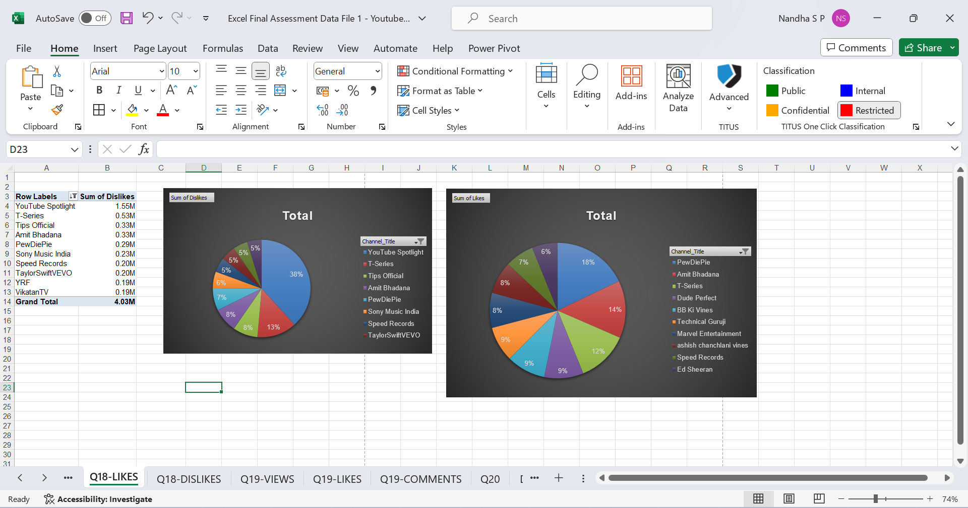
Q18
Insights

Slide 20
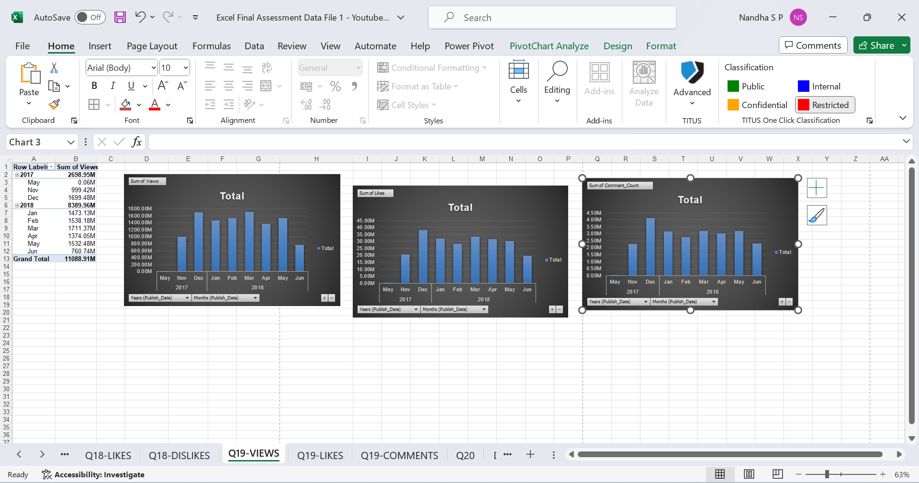
Q19
Insights

Slide 21
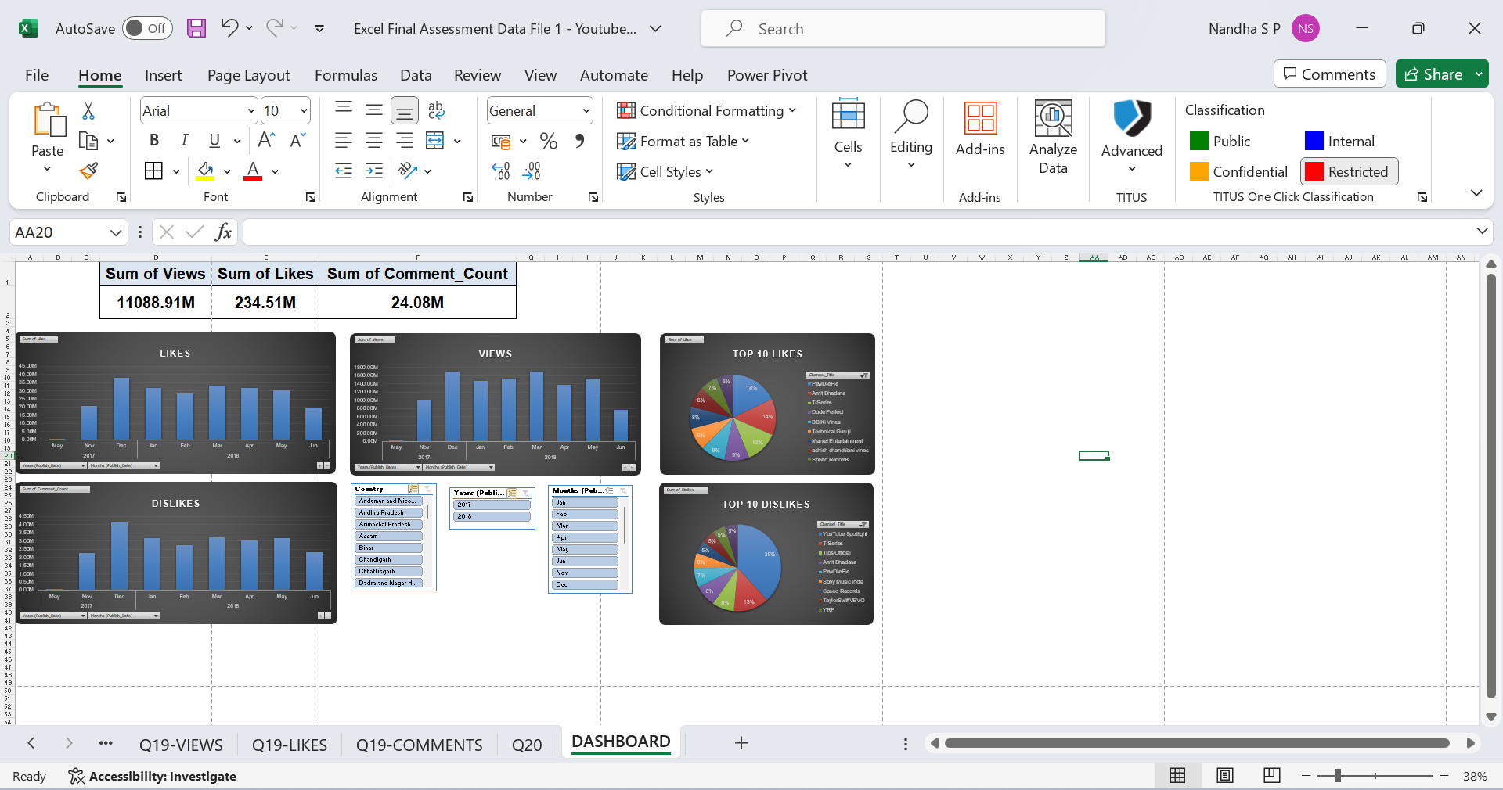
Q20
Insights

